Slide 1

People-Pulse Analytics Firm
IBM HR Analytics – Employee Attrition
Garima Sharma

Slide 2

Company Overview
IBM is a multinational technology company, known for pioneering innovation in IT solutions and services.
Employed approximately 282000 people worldwide
AI & Data Expertise
Provides hardware, software, and consulting services to help businesses undergo digital transformation.
Has presence in over 170 countries

Slide 3


Attrition can significantly impact a company's performance, productivity and workforce stability.
IBM, as a key player in the technology industry, faces the challenge of managing attrition to maintain its competitive advantage.
Understanding the underlying causes and developing strategies to mitigate employee turnover.
Business Problem

Slide 4
Dataset Overview
Dataset: IBM HR Analytics for Attrition
Dataset has 1470 rows and 27 Columns
Columns contains the demographics of the employee and relationship factors with company.
Handled the missing values, null values and cleaned the dataset for further analysis.

Slide 5
Employee_Attrition_Dashboard | Tableau Public
Tableau Visualization Of Data Overview and Statistical Test

Slide 6
Feature Selection
Features selected based on statistical test
Dropped the Categorical column which had no association with the target column
Dropped the Numerical column based on Upper Triangular Correlation matrix and statistical test
Splitted the Dataset into train and test for model building

Slide 7
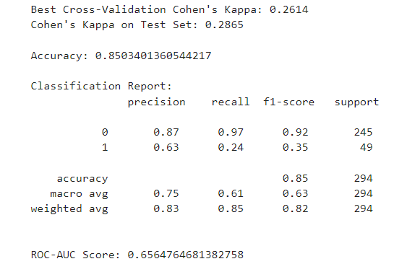
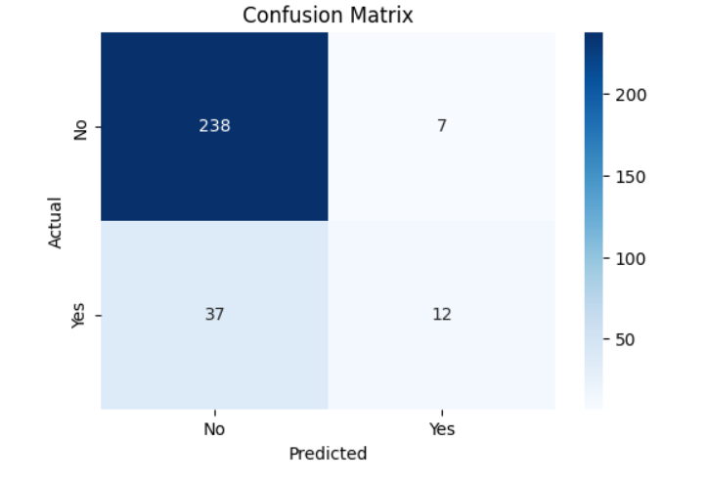
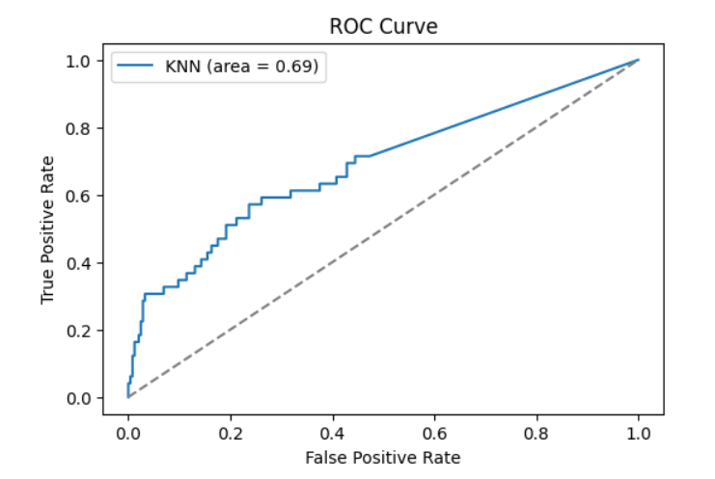
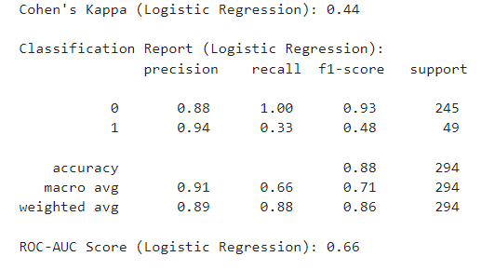
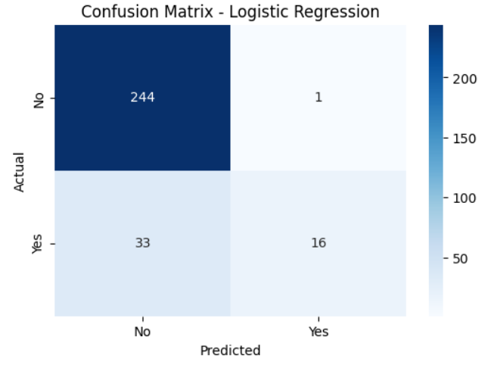
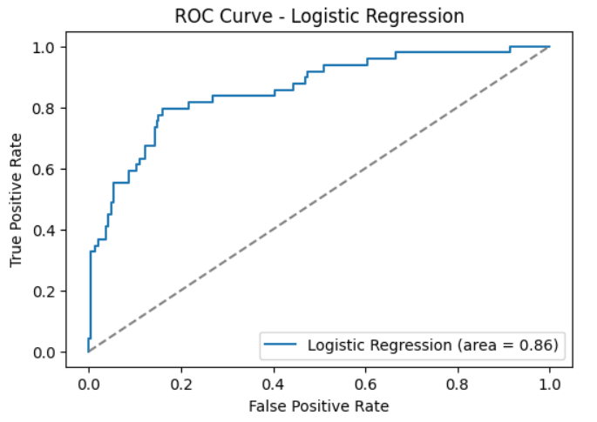
Hyperparameter Tuning and Model Evaluation
K-Nearest Neighbour(Grid Search and Cohen’s Kappa)
Logistic Regression (Cohen’s Kappa)

Slide 8
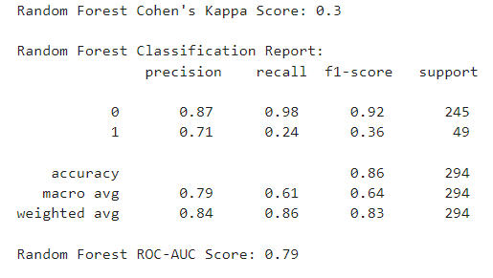
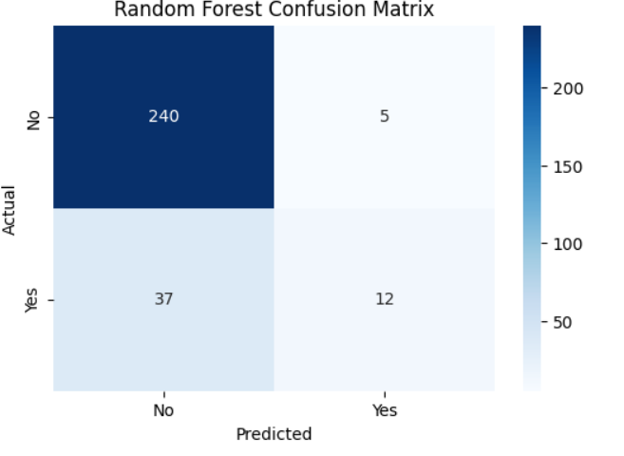
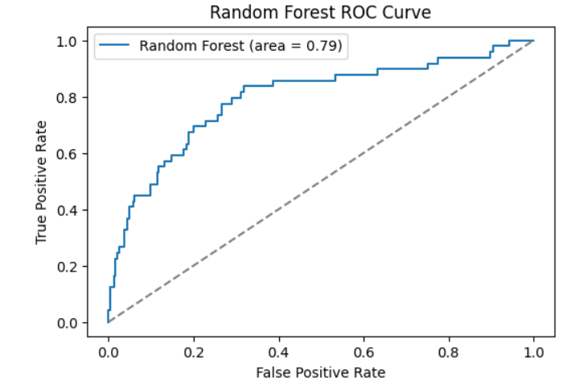
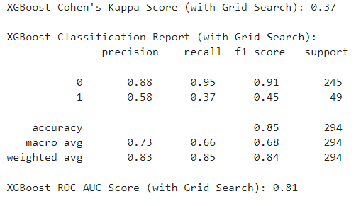
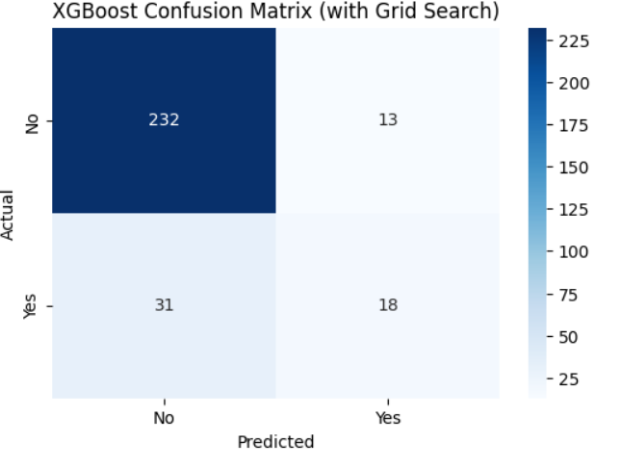
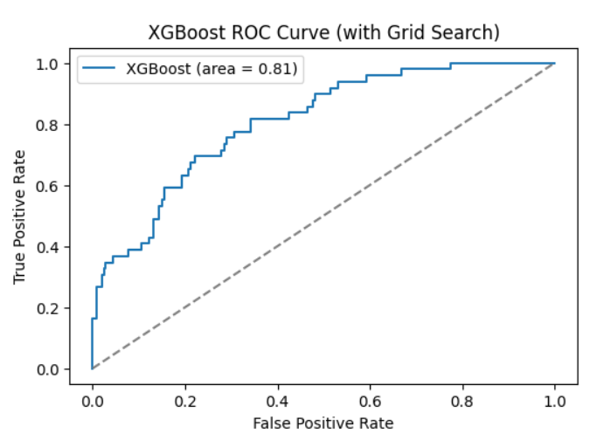
Hyperparameter Tuning and Model Evaluation
Random Forest Classifier (Grid Search and Cappa Cohen’s)
XGBoost Classifier(Grid Search and Cappa Cohen’s)

Slide 9
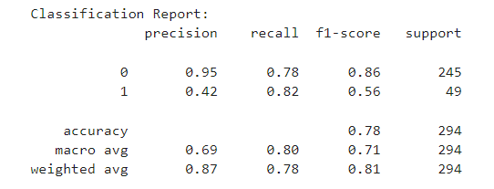
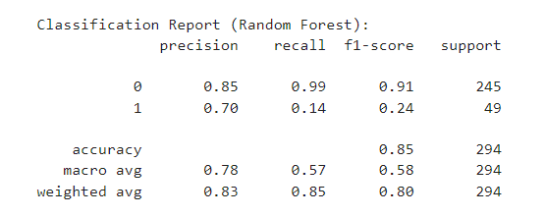
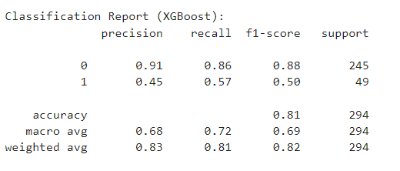
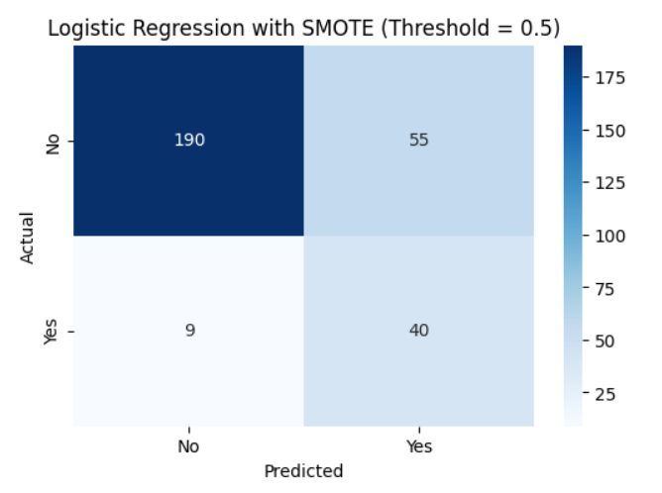
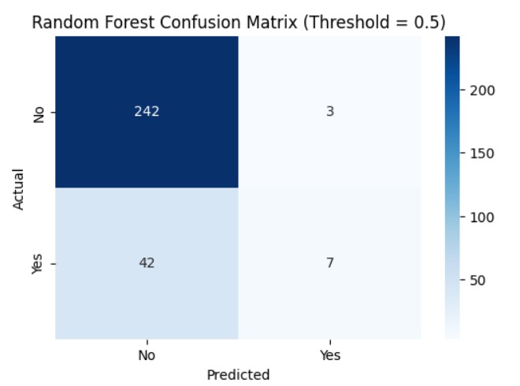
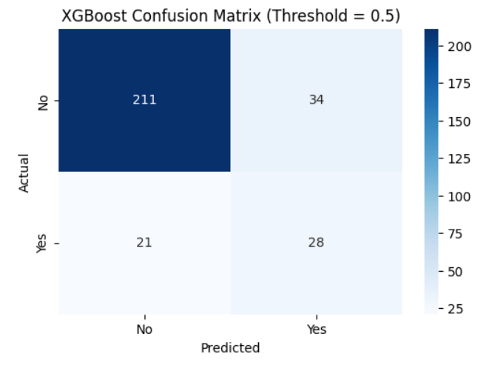
Handling Class Imbalance
Random Forest (weights_balance and threshold)
Logistic Regression (SMOTE)
XGBoost (scale_pos_weights)

Slide 10
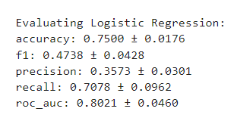
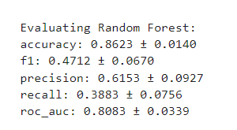
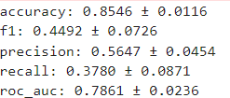
Cross Validation Evaluation Metrics After SMOTE

Slide 11
Challenges and Learnings
Selection
Time Management
Work Approach
Machine Learning
Keys Insight selection
Picking of right dataset and analyzing thoroughly before starting randomly
Completing the task in given time is the biggest challenge
Selecting how to proceed with the steps to achieve the targeted goal
Feature selection and model training methods
Selecting only the key insights for the
Presentation.

Slide 12

Recommendations
More Data can be collected so that we have more findings.
Can also have other columns like Feedback and Survey from employee.
Regularly audit the data to check for inconsistencies, missing values, or outliers that could distort the analysis.
Wellness Programs for employees.

Slide 13


Conclusion
Dataset had class imbalance where one class significantly outnumbers the other.
Accuracy of model is good but still model is not a good performer do due to class imbalance.
Dataset size is small.
After Class Imbalance the Model’s performance increased with respect to other parameters too.

Slide 14




Thank you
Garima Sharma

